Slide 1
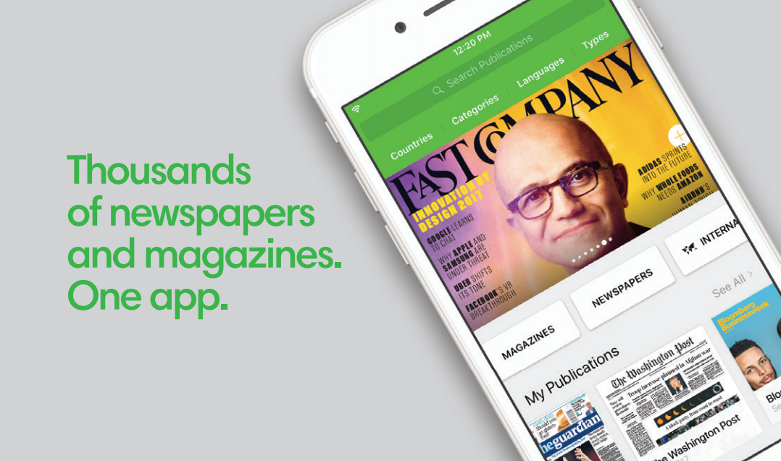

Slide 2
[Insert library logo here]
[Insert library URL here]

Slide 3
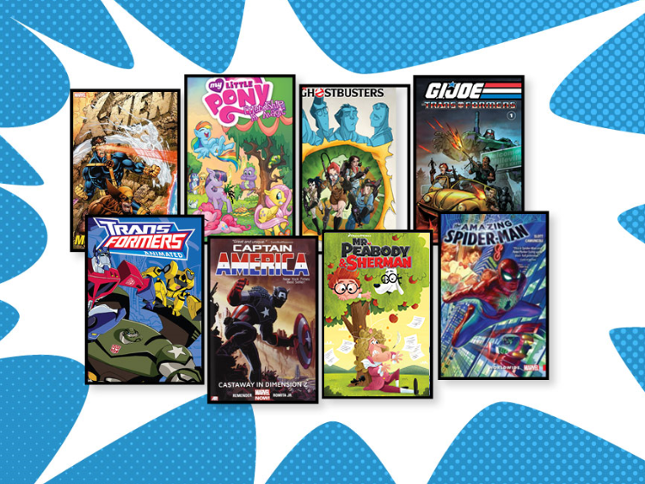
Download Comics Through Your Library’s Website
Unlimited Library Member Access to the Best Comics & Graphic Novels

Slide 6
Download audiobooks through your library’s website!
Mobile apps available!

Slide 7
Download audiobooks and magazines through your library’s website!
Mobile apps available!

Slide 8
Download audiobooks, magazines, and eBooks through your library’s website!
Mobile apps available!

